Slide 1

Automating Medical / RX Claims Matching
Sandy Lucev
Final Presentation
5/23/2020

Slide 2
Current Claims Matching Process
Complex – Unstructured Files
Files come in ~20 different formats
Each file may have 100,000 lines of data (we may need to merge 3-6 files each go)
Manual
Consolidating through excel results in excel crashing
Is more prone to human error
Time consuming
Avg turn around time is 2 hours for 1 client with 3 years of data. We collect 1,400 excels in 4 month timeframe and need to repeat process for ~300 clients.
Requires extensive peer review
Compliance - High risk with PHI
Stop Loss Claims Matching
Average TAT ~2hours

Slide 3
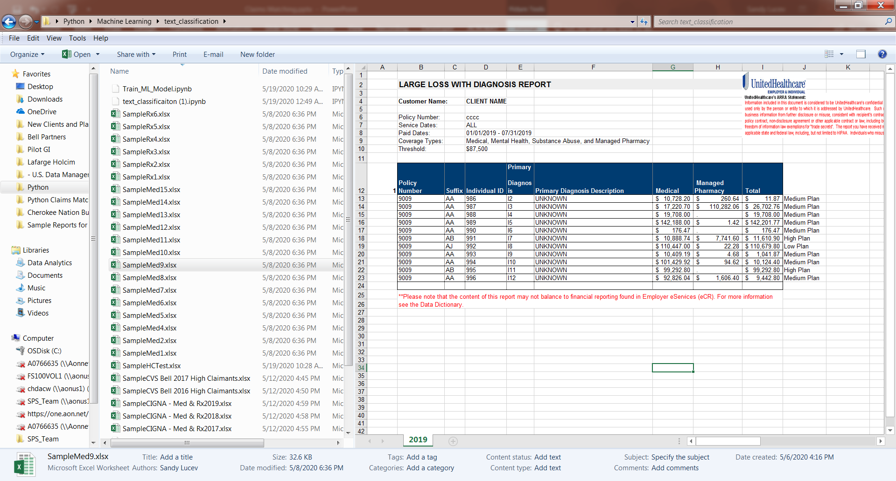
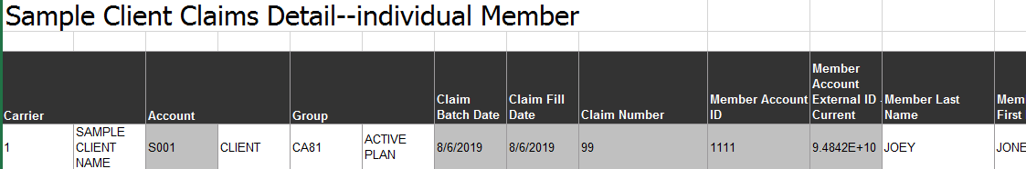
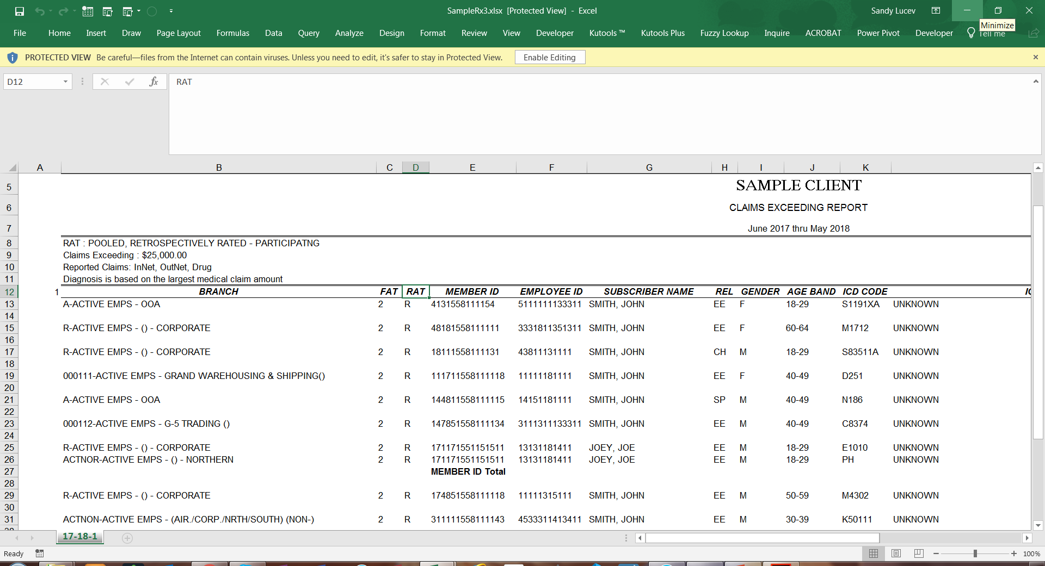
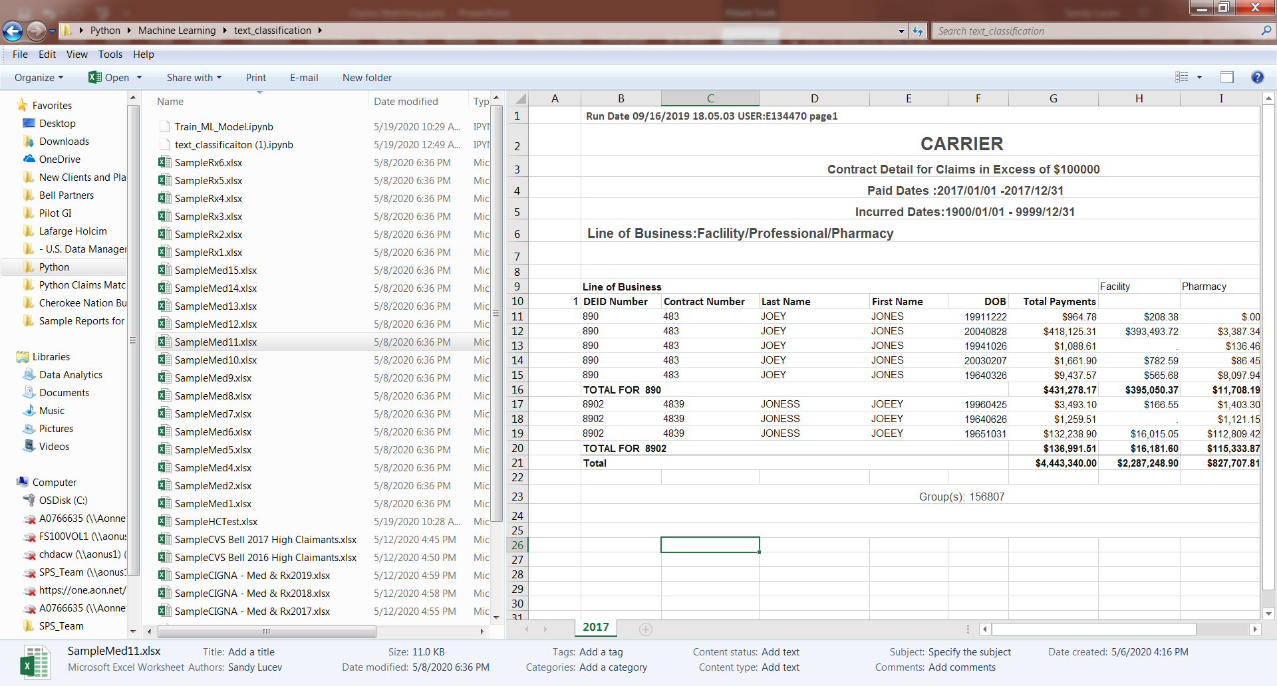
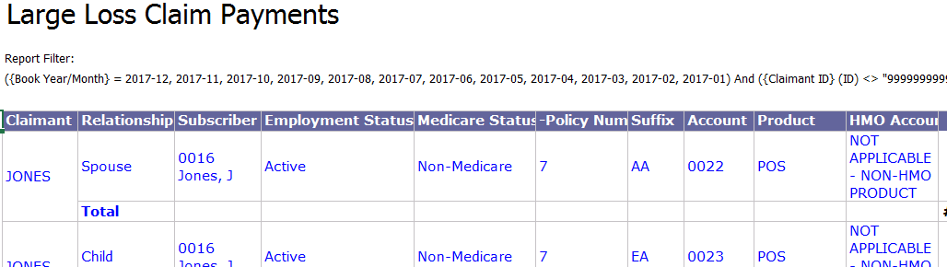
Medical / Rx Claim Files

Slide 4
Opportunity for Automation
Eliminate running files through Excel
Avoid excel crashing with large data sets
Improve TAT from 2 hours to less than 5 min.
Complex files from ~3 days to 15 min
~150k savings in 4months
Eliminate excel process

Slide 5

Automation Tools / Code
Python Code / Libraries used:
GLOB - Import files / sheets
PANDAS - Clean / transform data
XLRD / OPENPYXL - Write into files
RE – Machine Learning library to read all text in files
WordCloud – Matplotlib- visualization
Process:
Import all files
Merge all files into 1 data frame
Machine learning to identify data header
User Input to identify Unique Match (i.e. SSN, EE ID, Member ID)
Writes data back into each excel file

Slide 6
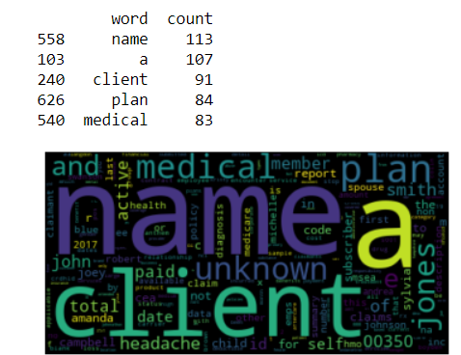
Wordcloud Visualization
In sample Machine Learning was able to create Wordcloud to show which words reoccurred the most. *testing data does not include client PHI

Slide 7
Deployment
Challenges:
Working on PyInstaller to create an .exe file for users.
Pyinstaller does not accept /read .sav files
GUI creation for input
Demo

Slide 8

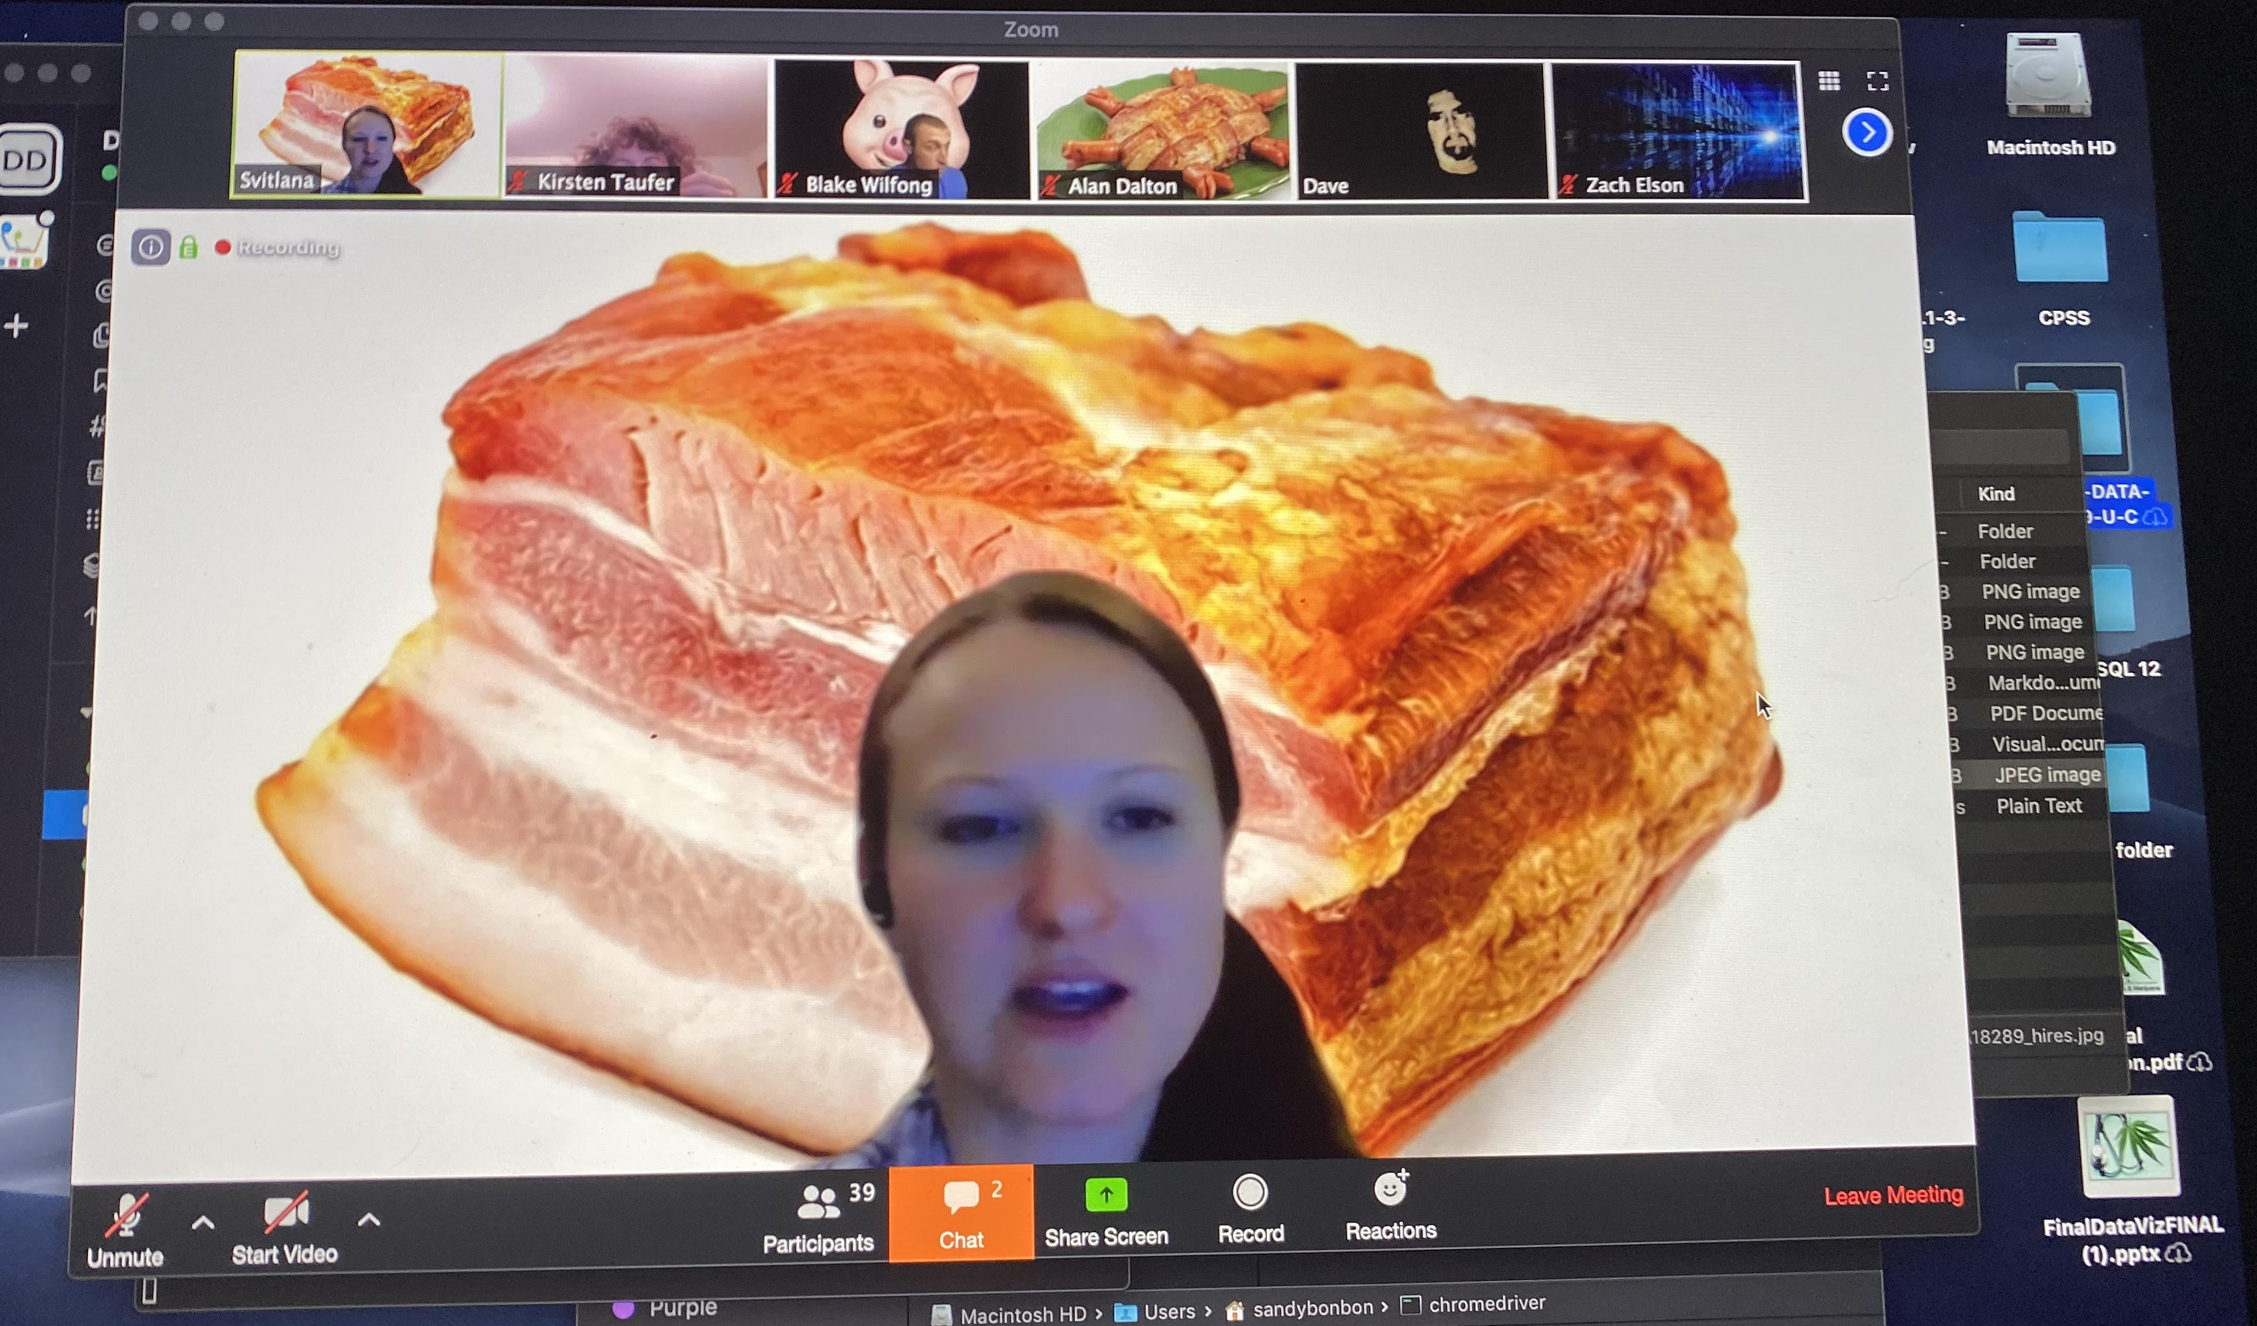
Thank you!
Thank you Svetlana and TAs for all the support, long hours, patience, and love for teaching!
Hope to keep in touch with you all.
Its been a journey… we made it!
Congrats to fellow classmates!
It’s been fun!!!!

